Slide 1

软件工程专业英语
计算机科学学院
School of Computer Science
Unit 1：Starting a Software Project

Slide 2
Outline
1. Part 1, Dialogue: Starting a Software Project
2. Part 2, Translating: Software Engineering

Slide 3
Part 1, Dialogue: Starting a Software Project
Main Content
出现的人物包括软件学院的教师（Teacher）和大二的三名学生（Kevin，Sharon，Jason）。
教师要求学生完成一个实际的项目作为课程设计，允许学生自选题目，并且鼓励团队合作。
Kevin，Sharon和Jason组成了一个团队，他们以Four Seasons Hotel Management Information System作为项目选题。
他们讨论了角色分工和初步的进度计划，了解了项目的初步需求，并且明确接下来的工作是电话约Four Seasons Hotel的相关人员见面，以进一步明确项目需求。

Slide 4

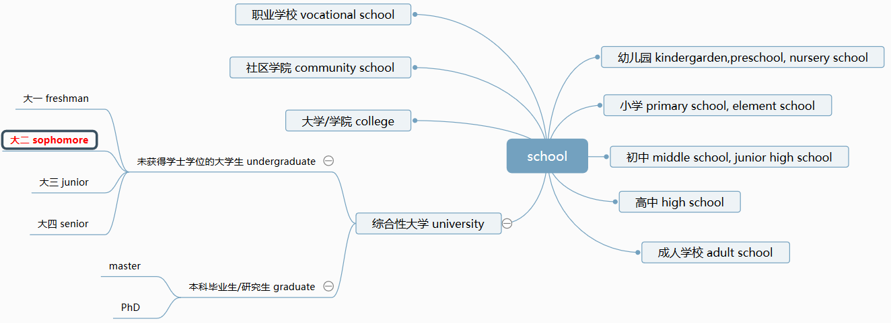
Part 1, Dialogue: Starting a Software Project
Words & Phrases
Notes:
sophomore: soph- 智慧，more-需要更多

Slide 5

Part 1, Dialogue: Starting a Software Project
in terms of
根据，就…而言，在…方面
Our goods compete in terms of product quality, reliability and above all variety.
我们的产品在质量、可靠性，尤其是品种方面颇具竞争力。

Slide 6
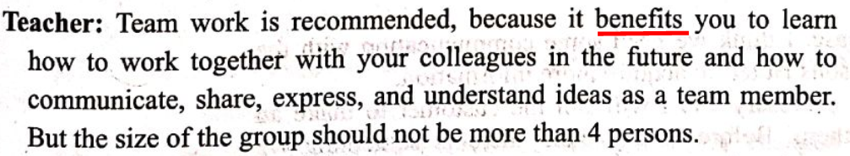
Part 1, Dialogue: Starting a Software Project
benefit
[U, C] 优势, 益处, 成效
[VN] 对（某人）有用, 使受益
[V] ~ (from/by sth) 得益于
The new regulations will be of benefit to everyone concerned.
新规章将使所有有关人员受益。
If you benefit from something or if it benefits you, it helps you or improves your life.

Slide 7
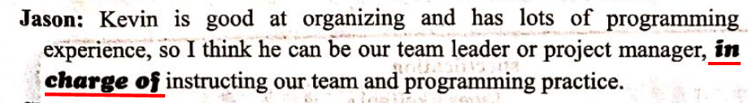
Part 1, Dialogue: Starting a Software Project
be responsible for 为…负责，是造成…的原因
be in charge of 主管，负责; 照料
take charge of 负责; 担任; 照管; 监理
He's in charge of the hospital.
Dr. Smith is assigned to take charge of the department.
The policeman said he would take charge of the gun.
那个警察说他来看管这支枪。
I am responsible for the matter. None of other's business.
这件事由我负责，跟旁人不相干。

Slide 8
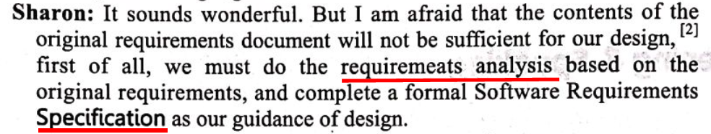
Part 1, Dialogue: Starting a Software Project
specification
[C, U] 规格；规范；明细单；说明书
a detailed description of how sth is, or should be, designed or made .
The house has been built exactly to our specifications .
房子完全是按照我们的工程设计书建造的。

Slide 9
Outline
1. Part 1, Dialogue: Starting a Software Project
2. Part 2, Translating: Software Engineering

Slide 10
The 1st paragraph
Virtually all countries now depend on complex computer-based systems. National infrastructures [ˈɪnfrəstrʌktʃər] and utilities [juːˈtɪləti] rely on computer based systems and most electrical products include a computer and controlling software. Industrial manufacturing and distribution is completely computerized, as is the financial system. Therefore, producing and maintaining software cost-effectively is essential [ɪˈsenʃl] for the functioning of national and international economies.
virtual [ˈvɜːrtʃuəl]
adj.
1）很接近的; 几乎…的; 事实上的; 实际上的; 实质上的
2） (通过计算机软件，如在互联网上)模拟的，虚拟的
virtual reality 虚拟现实
virtual function/method 虚函数

Slide 11
The 1st paragraph
Virtually all countries now depend on complex computer based systems. National infrastructures [ˈɪnfrəstrʌktʃər] and utilities [juːˈtɪləti] rely on computer based systems and most electrical products include a computer and controlling software. Industrial manufacturing and distribution is completely computerized, as is the financial system. Therefore, producing and maintaining software cost-effectively is essential [ɪˈsenʃl] for the functioning of national and international economies.
infrastructure ['ɪnfrə.strʌktʃər]
n.（国家或机构的）基础设施；Web基础建设；基础结构；基础架构
The product itself has no hardware like a CPU or hard drive, this infrastructure is provided by the service provider.
该产品本身没有CPU或硬盘这样的硬件，这个基础设施是由服务供应商提供的。
Because so much of the infrastructure is provided by the base class, it is relatively easy to develop your own Windows Forms controls.
由于基类提供了很多基础结构，开发自己的Windows窗体控件变得相对简单了。

Slide 12
The 1st paragraph
Virtually all countries now depend on complex computer based systems. National infrastructures [ˈɪnfrəstrʌktʃər] and utilities [juːˈtɪləti] rely on computer-based systems and most electrical products include a computer and controlling software. Industrial manufacturing and distribution is completely computerized, as is the financial system. Therefore, producing and maintaining software cost-effectively is essential [ɪˈsenʃl] for the functioning of national and international economies.
utility
[C] 公用事业 ; 实用程序
[U] 实用；效用；有用
The previous example illustrated the control of domains using the command-line utility virsh.
上一个例子说明了如何使用命令行工具virsh实现对域的控制。

Slide 13
The 1st paragraph
Virtually all countries now depend on complex computer based systems. National infrastructures [ˈɪnfrəstrʌktʃər] and utilities [juːˈtɪləti] rely on computer based systems and most electrical products include a computer and controlling software. Industrial manufacturing and distribution is completely computerized, as is the financial system. Therefore, producing and maintaining software cost-effectively is essential [ɪˈsenʃl] for the functioning of national and international economies.
computerize [kəmˈpjuːtəraɪz]
[VN]
用计算机做；使计算机化；使电脑化
用计算机储存，用电脑储存（信息）
as 作连词（conj.），意为“正如”“如同”，引导非限制性定语从句
1）从句正常语序：The financial system is (also) completely computerized.
2）从句省略谓语的一部分，并且倒装。
【例】Water waves are propagated in the form of a sine ware, as are electromagnetic (地磁波) wares.

Slide 14
The 1st paragraph
Virtually all countries now depend on complex computer based systems. National infrastructures [ˈɪnfrəstrʌktʃər] and utilities [juːˈtɪləti] rely on computer based systems and most electrical products include a computer and controlling software. Industrial manufacturing and distribution is completely computerized, as is the financial system. Therefore, producing and maintaining software cost-effectively is essential [ɪˈsenʃl] for the functioning of national and international economies.
cost-effective 或者 cost effective：具有成本效益的。
类似的合成词有：
energy efficient
energy saving
time saving
time consuming

Slide 15
The 2nd paragraph
Software engineering is an engineering discipline ['dɪsəplɪn] whose focus is the cost-effective development of high-quality software systems. Software is abstract and intangible [ɪnˈtændʒəbl]. It is not constrained [kənˈstreɪn] by materials or governed by physical laws or by manufacturing processes. In some ways, this simplifies software engineering as they are not physical limitations on the potential of software. However, this lack of natural constraints means that software can easily become extremely [ɪkˈstriːmli] complex and hence very difficult to understand.
engineering discipline：工程学科

Slide 16
The 2nd paragraph
Software engineering is an engineering discipline ['dɪsəplɪn] whose focus is the cost-effective development of high-quality software systems. Software is abstract and intangible [ɪnˈtændʒəbl]. It is not constrained [kənˈstreɪn] by materials or governed by physical laws or by manufacturing processes. In some ways, this simplifies software engineering as they are not physical limitations on the potential of software. However, this lack of natural constraints means that software can easily become extremely [ɪkˈstriːmli] complex and hence very difficult to understand.
intangible：无形的；难以形容(或理解)的；不易度量的

Slide 17
The 2nd paragraph
Software engineering is an engineering discipline ['dɪsəplɪn] whose focus is the cost-effective development of high-quality software systems. Software is abstract and intangible [ɪnˈtændʒəbl]. It is not constrained [kənˈstreɪn] by materials or governed by physical laws or by manufacturing processes. In some ways, this simplifies software engineering as they are not physical limitations on the potential of software. However, this lack of natural constraints means that software can easily become extremely [ɪkˈstriːmli] complex and hence very difficult to understand.
in some ways 在某些方面
in some cases 在某些情况
in some sense 在某种意义上
in some degree 在某种程度上
in some detail 较为详细
as 表原因

Slide 18
The 2nd paragraph
Software engineering is an engineering discipline ['dɪsəplɪn] whose focus is the cost-effective development of high-quality software systems. Software is abstract and intangible [ɪnˈtændʒəbl]. It is not constrained [kənˈstreɪn] by materials or governed by physical laws or by manufacturing processes. In some ways, this simplifies software engineering as they are not physical limitations on the potential of software. However, this lack of natural constraints means that software can easily become extremely [ɪkˈstriːmli] complex and hence very difficult to understand.

Slide 19
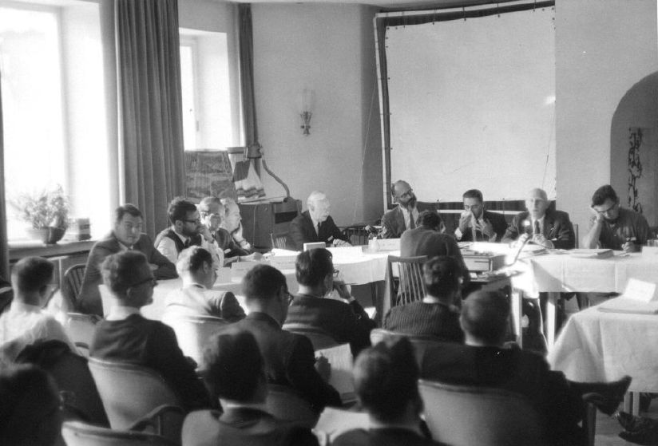
The 3rd paragraph
The notion of software engineering was first proposed in 1968 at a conference held to discuss what was then called the software crisis. This software crisis resulted directly from the introduction of new computer hardware based on integrated [ˈɪntɪɡreɪtɪd] circuits. Their power made hitherto [ˌhɪðərˈtuː] unrealizable computer applications a feasible proposition [ˌprɑːpəˈzɪʃn]. The resulting software was orders of magnitude larger and more complex than previous software systems.
分词作定语修饰前面的conference
1968年秋季，NATO（北约）的科技委员会召集了近50名一流的编程人员、计算机科学家和工业界巨头，讨论和制定摆脱“软件危机”的对策。在那次会议上第一次提出了软件工程（software engineering）这个概念。
http://homepages.cs.ncl.ac.uk/brian.randell/NATO/N1968/index.html
NATO Software Engineering Conference
Garmisch, Germany, 7-11 Oct 1968

Slide 20
The 3rd paragraph
The notion of software engineering was first proposed in 1968 at a conference held to discuss what was then called the software crisis. This software crisis resulted directly from the introduction of new computer hardware based on integrated [ˈɪntɪɡreɪtɪd] circuits. Their power made hitherto [ˌhɪðərˈtuː] unrealizable computer applications a feasible proposition [ˌprɑːpəˈzɪʃn]. The resulting software was orders of magnitude larger and more complex than previous software systems.
result from 由于
This helps avoid bugs that result from unintentional use of uninitialized variables.
这有助于避免因意外使用了未经初始化的变量而导致的bug。
result in 导致
This can result in a variety of scalability and maintenance problems.
这会导致各种可伸缩性和维护问题。

Slide 21
The 3rd paragraph
The notion of software engineering was first proposed in 1968 at a conference held to discuss what was then called the software crisis. This software crisis resulted directly from the introduction of new computer hardware based on integrated [ˈɪntɪɡreɪtɪd] circuits. Their power made hitherto [ˌhɪðərˈtuː] unrealizable computer applications a feasible proposition [ˌprɑːpəˈzɪʃn]. The resulting software was orders of magnitude larger and more complex than previous software systems.
orders of magnitude：数量级; 量级;
The device speed has improved by two orders of magnitude since 1960.
自1960年至今，器件速度已改善了两个数量级。
This model is orders of magnitude higher in complexity than the model for a static architecture.
这种模型与静态架构模型相比，在管理复杂性上有了极大的提高。

Slide 22
The 4th paragraph
Early experience in building these systems showed that informal software development was not good enough.
Major projects were sometimes years late.
The software cost much more than predicted, was unreliable, was difficult to maintain and performed poorly.
Software development was in crisis. Hardware costs were tumbling [ˈtʌmblɪŋ] whilst [waɪlst] software costs were rising rapidly.
tumble v.(使)跌倒，摔倒，滚落，翻滚下来; 倒塌;坍塌; (价格或数量)暴跌，骤降
New techniques and methods were needed to control the complexity inherent in large software systems.

Slide 23
The 5th paragraph
These techniques have become part of software engineering and are now widely used.
However, as our ability to produce software has increased, so has the complexity of the software systems that we need.
So 放在句首，代替前述肯定谓语所述的情况，而这种情况同时也适于后述主语时，应采用主谓倒装语序。
All animals need oxygen, so do plants.
所有动物都需要氧气，植物也需要。
New technologies resulting from the convergence [kənˈvɜːrdʒəns] of computers and communications systems and complex graphical user interfaces place new demands on software engineers.
As many companies still do not apply software engineering techniques effectively, too many projects still produce software that is unreliable, delivered late and over budget.

Slide 24
The 6th paragraph
We have made tremendous [trəˈmendəs] progress since 1968 and that the development of software engineering has markedly improved our software.
tremendous
1）巨大的；极大的
2）极好的；精彩的；了不起的
We have a much better understanding of the activities involved in software development.
We have developed effective methods of software specification, design and implementation.
New notations and tools reduce the effort required to produce large and complex systems.

Slide 25
The 7th paragraph
We know now that there is no single “ideal approach” to software engineering.
The wide diversity [daɪˈvɜːrsiti] of different types of systems and organizations that use these systems means that we need a diversity of approaches to software development.
However, fundamental [ˌfʌndəˈmentl] notions of process and system organization underlie all of these techniques, and these are the essence [ˈesns] of software engineering.
a diversity of 各种各样的
various kinds of 各种类型的;各种各样的
Diversity of data formats: There's a diversity of the data format being exchanged.
数据格式的多样性：存在多种数据交换格式

Slide 26
The 8th paragraph
Software engineers can be rightly proud of their achievements.
Without complex software we would not have explored space, would not have the Internet and modern telecommunications, and all forms of travel would be more dangerous and expensive.
Software engineering has contributed [kənˈtrɪbjuːt] a great deal and as the discipline matures, its contributions in the 21st century will be even greater.
1）contribute (sth) (to/towards sth) 捐献，捐赠（尤指款或物）；捐助
2）contribute (to sth) 是…的原因之一
3）contribute (sth) to sth 增加；增进；添加（到某物）
We contributed £5 000 to the earthquake fund.
我们向地震基金捐赠了 5 000 英镑。
Medical negligence was said to have contributed to her death.
据说医务人员的玩忽职守是她死亡的原因之一。
This book contributes little to our understanding of the subject. 此书对我们了解这门学科助益甚少。
26

